Slide 1
RED BLACK TREE

Slide 2
Properties of Red Black Tree:
1
3
5
2
4
ROOT PROPERTY
EXTERNAL PROPERTY
INTERNAL PROPERTY
DEPTH PROPERTY
PATH PROPERTY
The root is black.
Every leaf (Leaf is a NULL child of a node) is black in Red-Black tree.
The children of a red node are black. Hence possible parent of red node is a black node.
All the leaves have the same black depth.
Every simple path from root to descendant leaf node contains same number of black nodes.

Slide 3

WHY RED BLACK TREES?
1
Search
O(log n)
Most of the BST operations (e.g., search, max, min, insert, delete.. etc) take O(h) time where h is the height of the BST. The cost of these operations may become O(n) for a skewed Binary tree. If we make sure that the height of the tree remains O(log n) after every insertion and deletion, then we can guarantee an upper bound of O(log n) for all these operations. The height of a Red-Black tree is always O(log n) where n is the number of nodes in the tree.
2
Insert
O(log n)
3
Delete
O(log n)

Slide 4
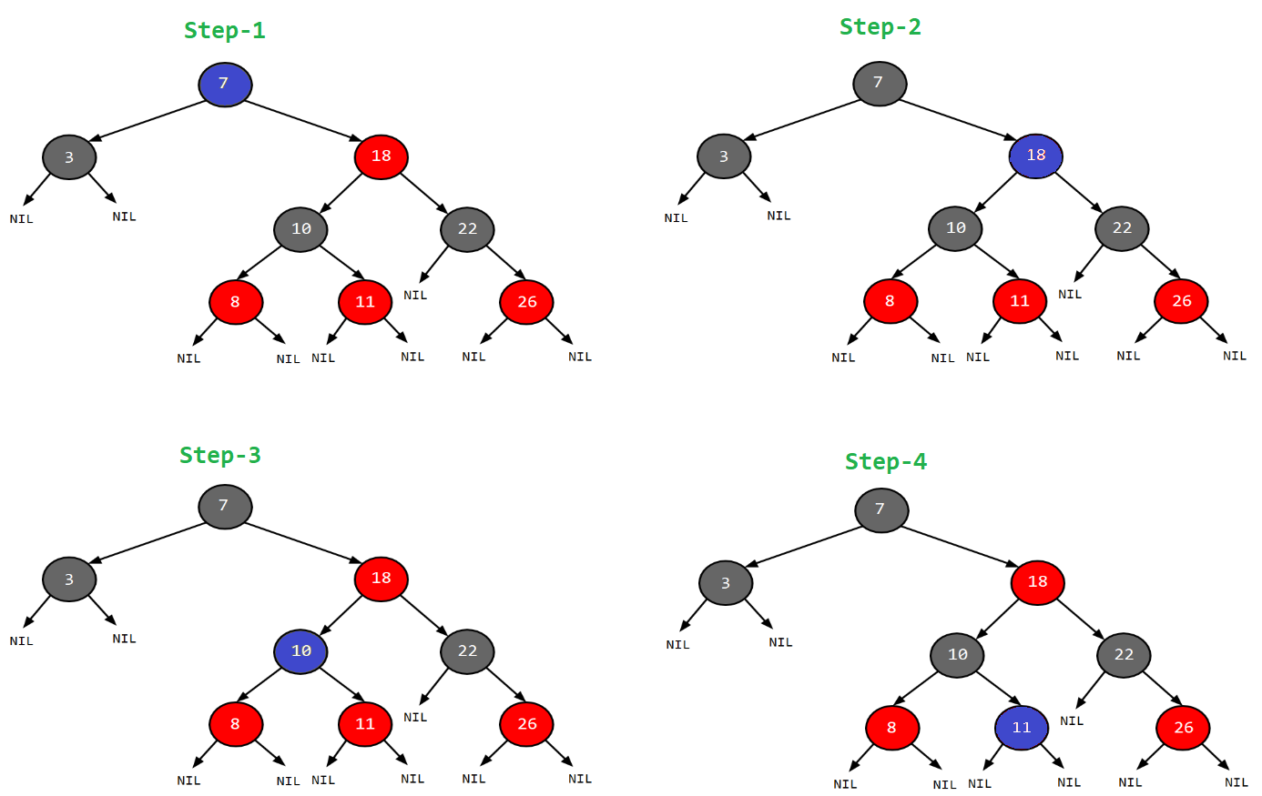
Example : Search for 11
Just follow the blue bubble

Slide 5
SEARCH ALGORITHM
New Project Timeline
searchElement (tree, val)
Step 1:
If tree -> data = val OR tree = NULL
Return tree
Else
If val < data
Return searchElement (tree -> left, val)
Else
Return searchElement (tree -> right, val)
[ End of if ]
[ End of if ]
Step 2: END
New Logo Identity
Promotional Material Templates
Set of graphic designs, illustrations & concepts for corporate materials

Slide 6










In the Red-Black tree, we use two tools to do the balancing.
1 Recoloring
2 Rotation
INSERTION

Slide 7
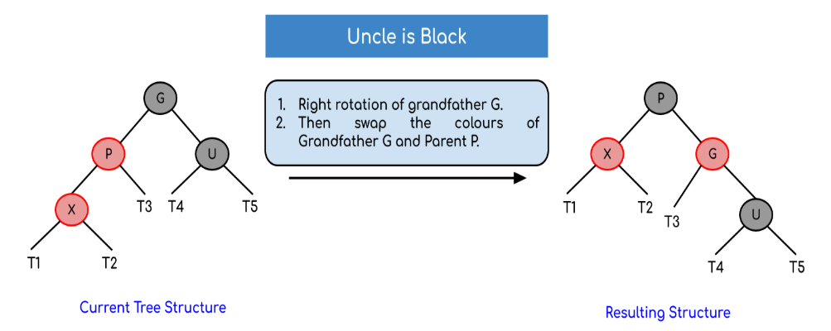
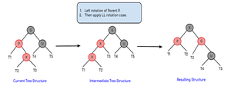
Rotation and Recoloring
LL Rotation
lr
Rotation

Slide 8
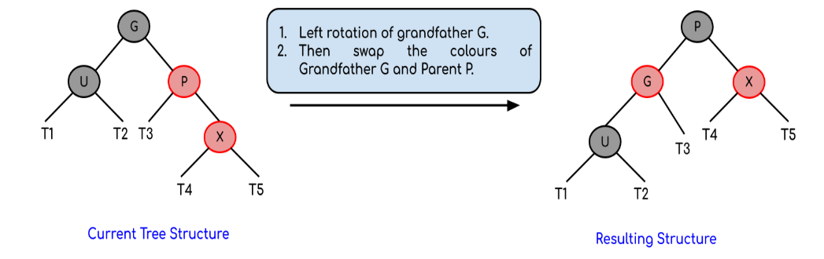
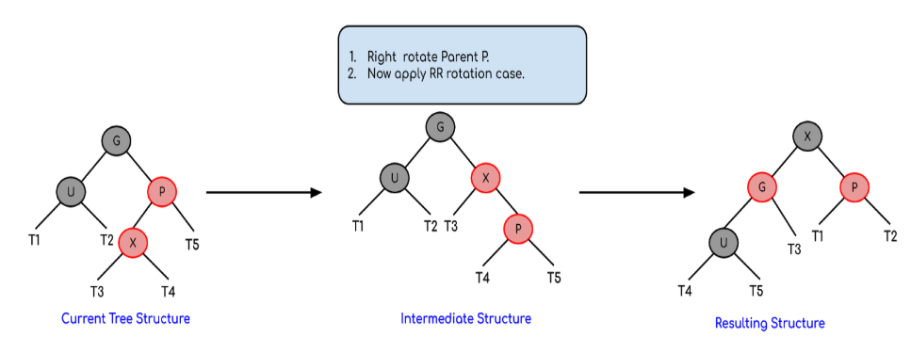
Rotation and Recoloring
rr Rotation
RL Rotation

Slide 9
INSERTION ALGORITHM
Let x be the newly inserted node.
Perform standard BST insertion and make the colour of newly inserted nodes as RED.
If x is the root, change the colour of x as BLACK (Black height of complete tree increases by 1).
Do the following if the color of x’s parent is not BLACK and x is not the root.
a) If x’s uncle is RED (Grandparent must have been black from property 4)
(i) Change the colour of parent and uncle as BLACK.
(ii) Colour of a grandparent as RED.
(iii) Change x = x’s grandparent, repeat steps 2 and 3 for new x.
b) If x’s uncle is BLACK, then there can be four configurations for x, x’s parent (p) and x’s grandparent (g) (This is similar to AVL Tree)
(i) Left Left Case (p is left child of g and x is left child of p)
(ii) Left Right Case (p is left child of g and x is the right child of p)
(iii) Right Right Case (Mirror of case i)
(iv) Right Left Case (Mirror of case ii)
Re-coloring after rotations:
For Left Left Case [3.b (i)] and Right Right case [3.b (iii)], swap colors of grandparent and parent after rotations
For Left Right Case [3.b (ii)]and Right Left Case [3.b (iv)], swap colors of grandparent and inserted node after rotations
New Logo Identity
Promotional Material Templates
Set of graphic designs, illustrations & concepts for corporate materials

Slide 10

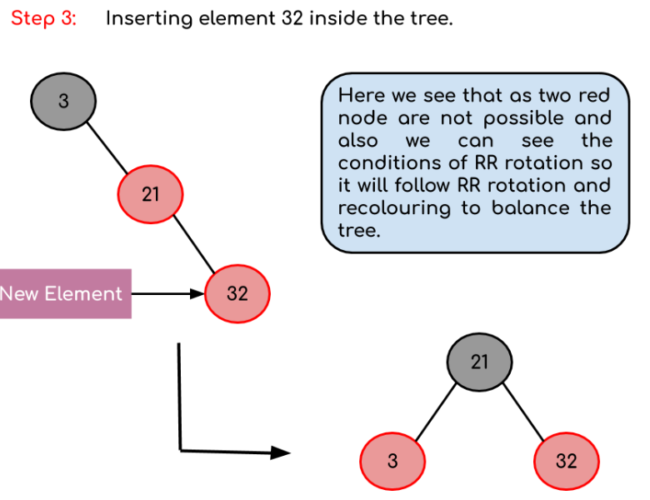

Insertion Example
Creating a red-black tree with elements 3, 21, 32 and 15

Slide 11
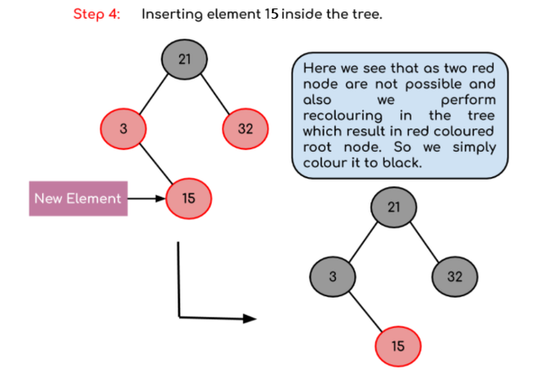

INSERTION EXAMPLE CONTINUED...
Creating a red-black tree with elements 3, 21, 32 and 15
Final Tree

Slide 12
Deletion in a red-black tree is a bit more complicated than insertion. When a node is to be deleted, it can either have no children, one child or two children.
DELETION

Slide 13
If the node to be deleted has no children, simply remove it and update the parent node.
If the node to be deleted has only one child, replace the node with its child.
If the node to be deleted has two children, then replace the node with its in-order successor, which is the leftmost node in the right subtree. Then delete the in-order successor node as if it has at most one child.
After the node is deleted, the red-black properties might be violated. To restore these properties, some color changes and rotations are performed on the nodes in the tree. The changes are similar to those performed during insertion, but with different conditions.
The deletion operation in a red-black tree takes O(log n) time on average, making it a good choice for searching and deleting elements in large data sets.
STEPS INVOLVED IN DELETION

Slide 14

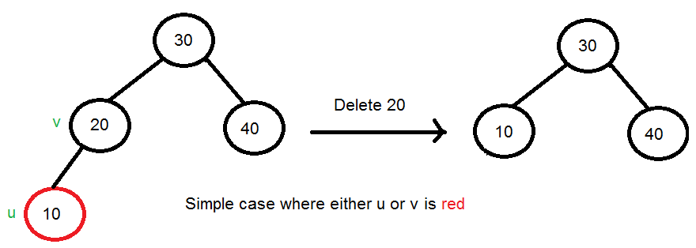


SIMPLE CASE
Simple Case: If either u or v is red, we mark the replaced child as black (No change in black height). Note that both u and v cannot be red as v is parent of u and two consecutive reds are not allowed in red-black tree.

Slide 15
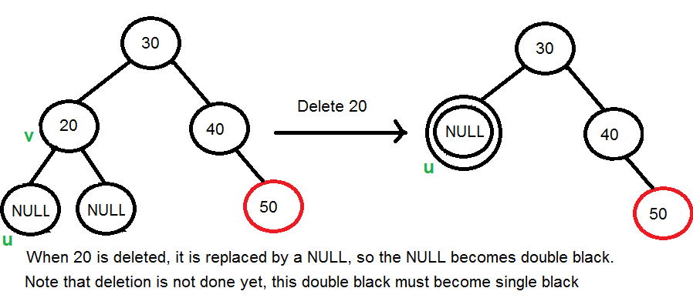
3) If Both u and v are Black.
3.1
Color u as double black. Now our task reduces to convert this double black to single black. Note that If v is leaf, then u is NULL and color of NULL is considered black. So the deletion of a black leaf also causes a double black.

Slide 16
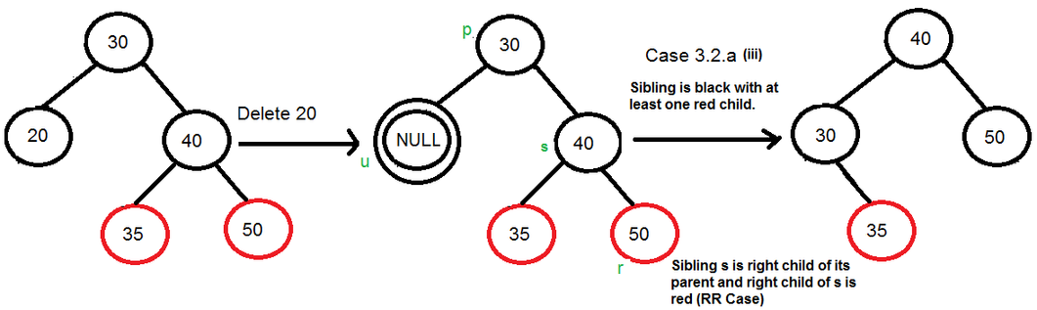
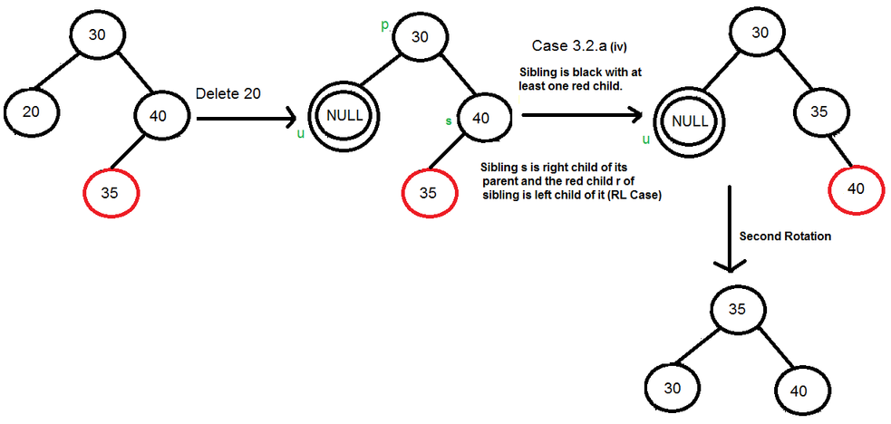
3.2 a
3.2) Do the following while the current node u is double black, and it is not the root. Let the sibling of node be s.
….(a): If sibling s is black and at least one of sibling’s children is red, perform rotation(s). Let the red child of s be r. This case can be divided into four subcases depending upon the positions of s and r.
…………..(i) Left Left Case (s is left child of its parent and r is left child of s or both children of s are red). This is mirror of right right case shown in the below diagram.
…………..(ii) Left Right Case (s is left child of its parent and r is right child). This is mirror of right left case shown in below diagram.
…………..(iii) Right Right Case (s is right child of its parent and r is right child of s or both children of s are red)
…………..(iv) Right Left Case (s is right child of its parent and r is left child of s)

Slide 17
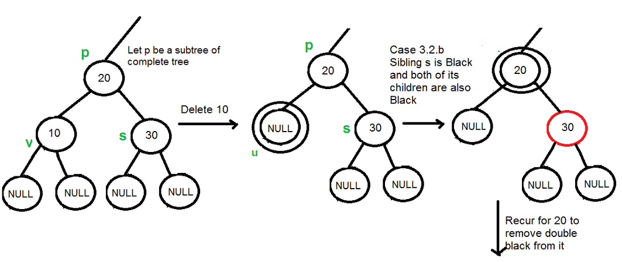
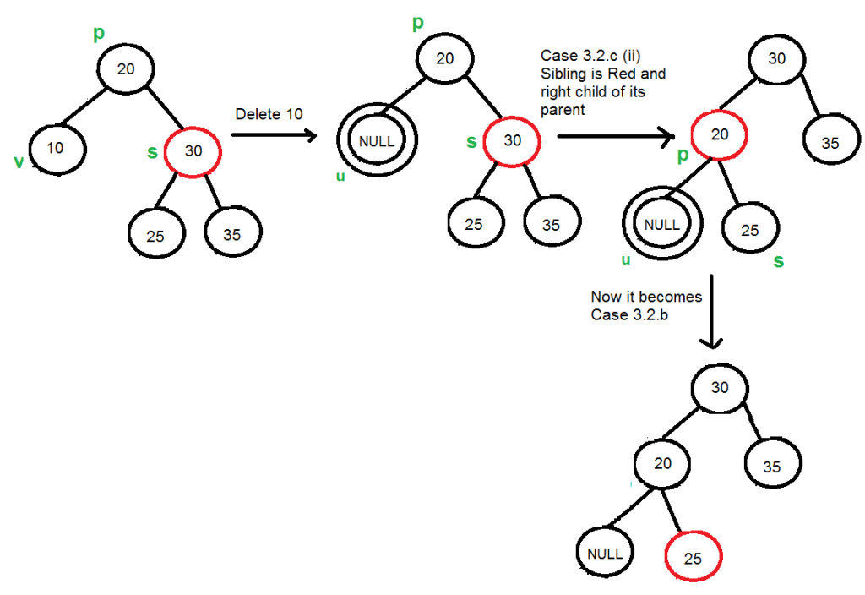
3.2) Do the following while the current node u is double black, and it is not the root. Let the sibling of node be s.
…..(b): If sibling is black and its both children are black, perform recoloring, and recur for the parent if parent is black.
In this case, if parent was red, then we didn’t need to recur for parent, we can simply make it black (red + double black = single black)
…..(c): If sibling is red, perform a rotation to move old sibling up, recolor the old sibling and parent. The new sibling is always black (See the below diagram). This mainly converts the tree to black sibling case (by rotation) and leads to case (a) or (b). This case can be divided in two subcases.
…………..(i) Left Case (s is left child of its parent). This is mirror of right right case shown in below diagram. We right rotate the parent p.
…………..(ii) Right Case (s is right child of its parent). We left rotate the parent p.
3.2 b and 3.2 c

Slide 18







If u is the root, make it single black and return (Black height of the complete tree reduces by 1).
3.3

